Slide 1

LifeCourse Community Event
APSE Presentation
June 14, 2018
Notes:
Do evaluation
Update Mo # slides

Slide 2
Outcomes for Today
Explore the effect of past and current policies and practices of the disability service system on available supports
Highlight the significant role families play in their members with disabilities lives across the lifespan
Introduce the LifeCourse Framework as a foundation for working with individuals with disabilities and their families to achieve a “good life”
Provide real life examples and strategies that can be used to impact the trajectory towards a “good life”
Notes:
First bullet – you all do policy everyday. We fight things, it causes change. Its important to understand the intent of federal laws and policies.
2nd bullet – this is not typical in our field. We tend to focus on providing the services the individual needs, like it has nothing to do with the person’s family! Or we talk about the family until the child is an adult and then we only talk about the person!
Last 2 bullets – Last thing we want to do is give you one more piece of paper to fill out. We want to provide tools you can supplement into your work IF and WHEN it makes sense! We hope these tools will integrate and enhance your conversations.

Slide 3
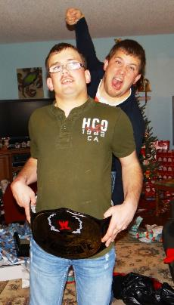
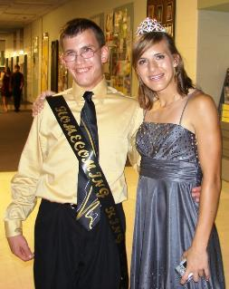
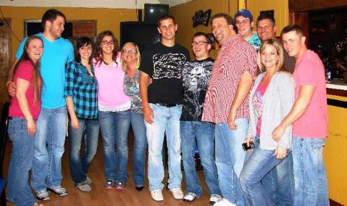

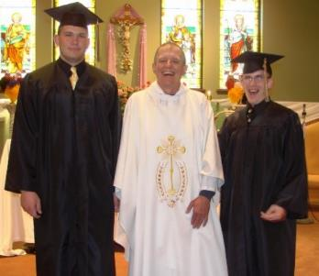
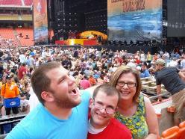
Setting the Stage

Slide 4
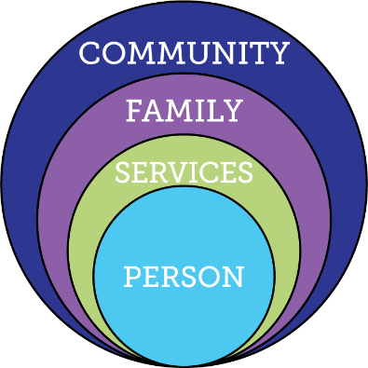
Current Reality of Service and Supports
Demand for Services
Expectations, Values, Culture
Federal Budget
Capacity of
Work Force
Federal Policy
Notes:
DEMAND for services going UP, while BUDGET is going DOWN. Workforce – females between 25 and 45, going DOWN. Elderly using $ and people resources that IDD also uses.
Expectations of younger generation that has grown up with FULL iinclusion.
Policy – moving away from institutional and congregate settings, and employment and community inclusion is an expectation.
Providers expected to do MORE for less
Key Federal Policy:
Developmental Disability Act
Individuals with Disabilities Education Act
Family and Medical Leave Act
Lifespan Respite Act
Older American’s Act
HCBS rules
Key Federal Initiatives
Medicaid Money Follows the Person
SSA Ticket to Work
Aging and Disability Resource Centers
HHS Community Living Initiative
Other Key Initiatives:
National Governors Association initiative “A Better Bottom Line: Employing People with Disabilities”
Key Federal Policy:
Developmental Disability Act
Individuals with Disabilities Education Act
Family and Medical Leave Act
Lifespan Respite Act
Older American’s Act
Key Federal Initiatives
Medicaid Money Follows the Person
SSA Ticket to Work
Aging and Disability Resource Centers
HHS Community Living Initiative
Other Key Initiatives:
National Governors Association initiative “A Better Bottom Line: Employing People with Disabilities”

Slide 5
Center for Medicaid Services- HCBS Final Rule: Settings
Federal Policy
Individuals have the right to receive services in the community to the same degree as those not receiving home and community based waiver services:
Individuals must be allowed to select the services they receive, where they live among available options, and the providers of those services.
Individuals have the freedom to control their own schedules, personal resources, and other aspects of their living arrangement.
Individuals must be treated with dignity and respect and be free from coercion or restraint.
Home and Community Based Services (HCBS) Final Federal Rule Presentation, 11/10/1

Slide 6
Center for Medicaid Services- HCBS Final Rule: Person Centered Planning
Federal Policy
Service plans for HCBS must be developed through a person-centered planning process that provides necessary information and support so that the individual can direct the process and make informed choices.
The process must be directed by the individual and the individual’s freely chosen representative and must reflect individual preferences and goals.
The plan must be written so that the individual can understand the plan.
From The Arc. National Policy Matters. The 2014 Federal Home and Community-Based Services Regulation:
What You Need to Knowhttp://www.thearc.org/document.doc?id=4596

Slide 7
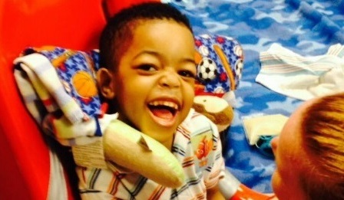
Guiding Principles For the
Supporting families LifeCourse Framework

Slide 8
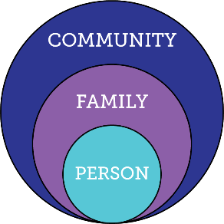
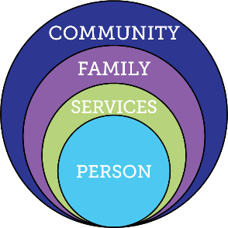
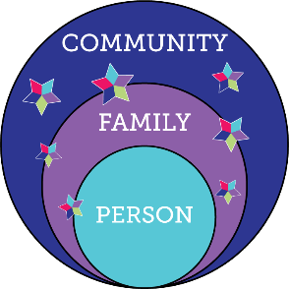
Services and Supports are Evolving
Everyone exists within the context of family and community
Integrated Services and Supports within context of person, family and community
Traditional
Disability Services

Slide 9
Type of Change that is Needed
Transitional CHange
Transformation Change
“Retooling” the system and its practices to fit the new model
Mergers, consolidations, reorganizations, revising systematic payment structures,
creating new services, processes, systems and products to replace the traditional one
Fundamental reordering of thinking, beliefs, culture, relationships, and behavior
Turns assumptions inside out and disrupts familiar rituals and structures
Rejects command and control relationships in favor of co-creative partnerships
Creating Blue Space, Hanns Meissner, 2013
Notes:
Transitional change – can’t just keep changing names and adding things on – have to think very differently.
The LifeCourse Framework is the way we can achieve Transformational Change
Have/change conversations; problem solve; navigate; educate; plan
Tools to give confidence, to start conversations, actually USE the tools

Slide 10
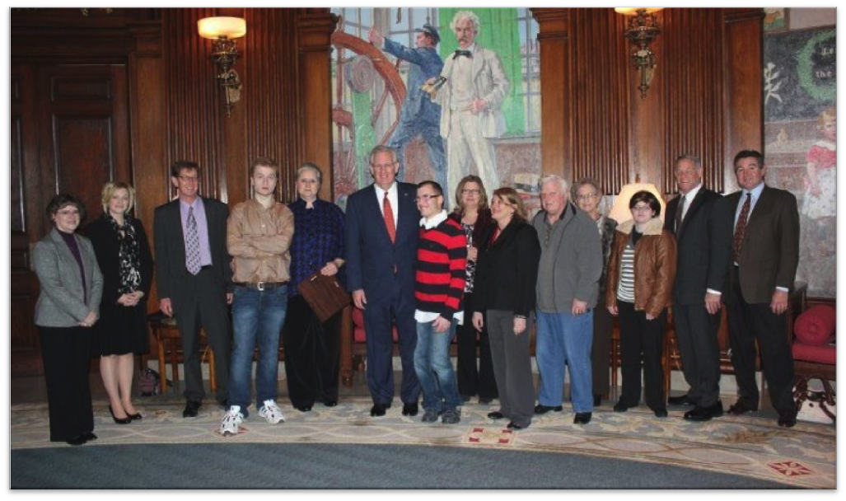
Policy, Systems & Community Change:
Person-/Family- Centered and Driven

Slide 11

Partnering with People with Disabilities and their Families so they can
Engage, Lead, and Drive
Policy and Systems Change

Slide 12


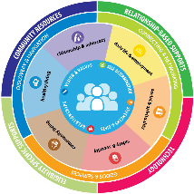




Comprehensive, Integrated & Coordinated Systems Across Life Domains & Stages
Pediatrician, Families and Friends, Faith based
IDEA Part C, Parents as Teachers, Health, Headstart
School, Special Education, Health, Recreation
Vocational Rehab, Health Employment, College, Military
Disability Services, Health, Housing, College, Careers
Retirement, Aging System, Health

Slide 13
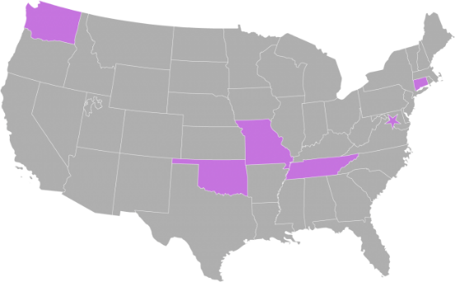
National Community of Practice on Supporting Families
Project Goal
To build capacity through a community of practice across and within States to create policies, practices and systems to better assist and support families that include a member with I/DD across the lifespan.
Project Outcome
State and national consensus on a national framework and agenda for improving support for families with members with I/DD.
Enhanced national and state policies, practices, and sustainable systems that result in improved supports to families.
Enhanced capacity of states to replicate and sustain exemplary practices to support families and systems.
Notes:
COP charged with developing a framework for supporting families
Chose to model after the life course theory
Informed by Wingspread-Building a National Agenda for Supporting Families with a member with IDD
Framework started with Mo F2F stakeholders. Plain language, not systems jargon.

Slide 14









Funded in 2012 by
National Partners

Slide 15
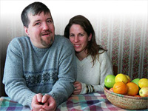
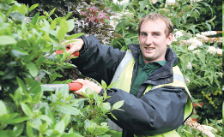
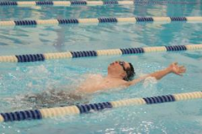
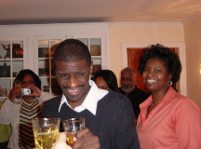
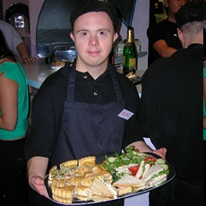
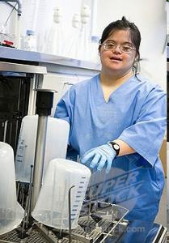
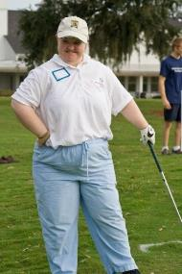
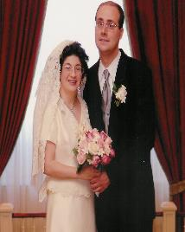
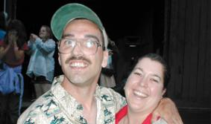
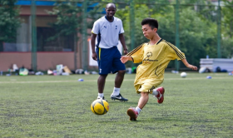
Core Belief:
All people and their families have the right to live, love, work, play
and pursue their life aspirations in their community.

Slide 16
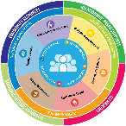

What is YOUR Vision
for a Good LIFE?
Vision of What I Want for a Quality of Life
Write down your responses on your worksheet & discuss with your table
Notes:
Ask the group Who said: Family/friends; vacations, pets, chocolate, etc
How many people said: Good Behavior Plan????
EVERYBODY “gets” what “good life” means

Slide 17
What DON’T you want??
Vision of What
I Don’t Want
Write down your responses on your worksheet
& discuss with your table
Notes:
Who said: Poverty, isolation, segregation, loneliness?
Ask the group for anything else they put there that hasn’t already been said.
Family sometimes cant envision the good life – too many barriers, always a fight. But they can almost always tell you what they DON’T want!

Slide 18



“Good Life for All ”
The Individual will achieve self-determination, interdependence, productivity, integration, and inclusion in all facets of community life
Families will be supported in ways that maximize their capacity, strengths, and unique abilities to best nurture, love, and support all individual members to achieve their goals

Slide 19
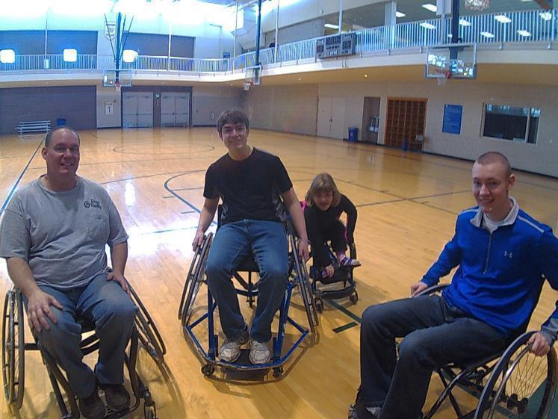
ALL People

Slide 20


1 in 4 Persons with I/DD
Receive Formal State DD Services
25%
100%
75%
4.7 Million people with developmental disabilities
National % Receiving State DD Services
** Based on national definition of developmental disability with a prevalence rate of 1.49%
Notes:
3 out of 4 are not getting and may never get paid DD services. Our job is to help the 3 get other kinds of support, and help ALL 4 figure out different ways of getting supports.

Slide 21
Alabamians with Disabilities
22%
76%
(75,314)
2%
ICF/DD
Enrolled HCBS DD Services
State DD Services
Targeted Case Management
Based on 1.58% prevalence of 3.815 million citizens, US Census
Notes:
Specific to Missouri – the 35% represents those that are KNOWN to the system. 19% get case management only, which if you ask an individual or family, means they aren’t getting any paid services! TCM used to be the “golden ticket” – before the Medicaid waivers, TCM meant that the SC was doing everything they could to help the individual have a good life even though they weren’t receiving paid services. We need to get back to our roots – LC tools help change THAT conversation – how can we help someone have a good life even when they get no paid services!!

Slide 22
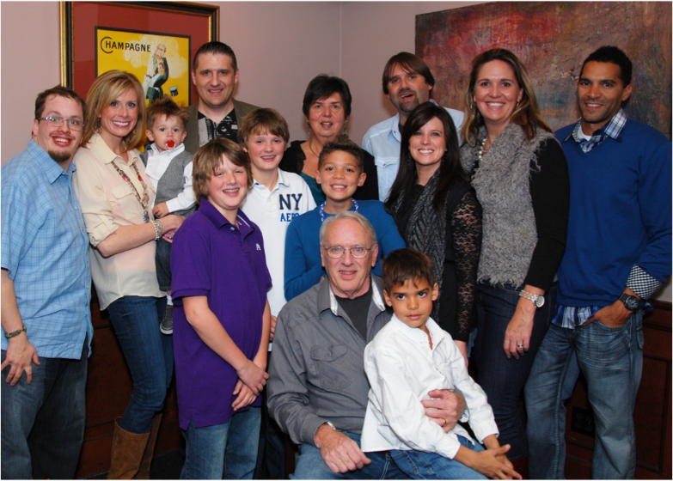
Person Within Context of Family & Community

Slide 23

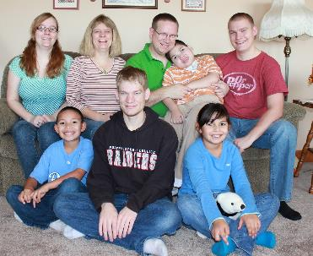
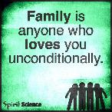
All individuals exist within the context of family
Family is defined by the individual
Individuals and their family may need supports that adjust as roles and needs of all members change
Not dependent upon where the person lives
Notes:
No matter if person lives with their family (or not), talks to (or not) or if the family goes to meetings with the person
We have to be OPEN to their definition of family!

Slide 24

Lifelong Impact of
Family on Individual
Biologically: Likes, dislikes, skills, abilities
Socially: Family and friend network, connection with community members
Environmentally: Neighborhood, socio-economic, education
Policy:
Dreams, Aspirations,
House rules, cultural rules, expectations
Notes:
Biology – are we tall or short? Do we inherit tendency for certain illness? What do I want to do or be?
Socially – impact of reputation of the family – good or bad (like in school if you had an older brother/sister attend before you); connected socially/social networks (what are those connections and reputations??)
Environmentally – the neighborhood we grow up in; our family’s education level, financial status;
Policy – house rules and expectations; important to understand expectations and norms. (everyone expected to go to college; make your bed every morning) Family CULTURE – so important – what you do on holiday, birthdays, traditions and things that are important in your family culture; how to hang stockings. WHO is going to know the family rituals???

Slide 25



Relationships and Roles of Family in a Person’s Life
Caring About | Affection & Self-Esteem
 | Repository of knowledge
 | Lifetime commitment
Caring For | Provider of day-to-day care
 | Material/Financial
 | Facilitator of inclusion and membership
 | Advocate for support
*Adapted from Bigby & Fyffe (2012), Dally (1988), Turnbull et all (2011)
Notes:
#1 fear of all parents/families --- what will happen when I’m GONE?
Having conversations with families (especially parents) about “Caring About” – who else can fill these roles when you are gone, and how can you start giving some of those things to others NOW while you are still around?
It doesn’t matter if you think you have all the “caring for” covered when you’re gone – what if it all falls apart? If there is no one that cares ABOUT the person to figure it out, then it’s all for naught.
AND who does the person care about? Do they send cards or call on birthdays for loved ones? Is there someone they are about that they also care FOR? (ie- interdependent relationships especially with older families)
RECIPROCAL - reciprocity

Slide 26

Families Support
Members with I/DD
89% of People I/DD receiving services are Supported by Family
Larson, S. A., Lakin, K. C., Anderson, L., Kwak, N., Lee, J. H., & Anderson, D. (2000).
Notes:
Old title: Where Do People with Disabilities Live AND Receive Services?

Slide 27
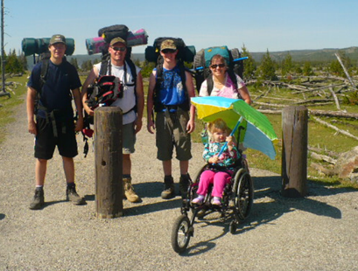
Life Trajectory, Experiences and Life Stages

Slide 28
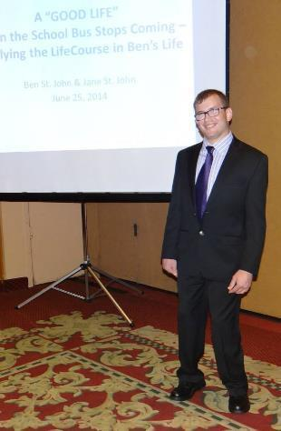
Introducing Ben

Slide 29
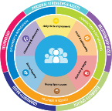
Vision for a Good Life
The future is not something we enter. The future is something that we create. And creating that future requires us to make choices and decisions that begin with a dream.
    -Leonard L. Sweet
Notes:
How can you plan with people if you don’t know their finish line?
Resource Center – we try to figure out WHY they are asking for a service – story about mom asking for DayHab because her son actually needed transportation to his job and dayhab has transportation.

Slide 30
Trajectory towards Good Life
Friends, family,
enough money,
job I like, home, faith, vacations, health, choice, freedom
Trajectory towards Life Outcomes
Vision of What I Don’t Want
Trajectory towards things unwanted
Notes:
What kinds of things did you say earlier for YOUR good life? PWD and families usually want those same types of things. Everybody “gets” what the good life is. We just don’t usually ask them! What kinds of things do you think PWD and families will say they DON’T want? Sometimes you need to start there – they may not know what they want (because they are thinking in disability world) but they almost always can tell you want they don’t. FAMILY should have a good life trajectory too
TRAJECTORY is the path that will either lead you toward the good life or toward things you don’t want. Think about throwing a football – the path that the ball takes on it’s way to the receiver is the trajectory. If you shoot an arrow, or a nerf gun – the path that the arrow follows is the trajectory. CAN START at ANY AGE!!!!
Support coordinators, providers, DSP’s, VR counselors, teachers….. ALL have the power to impact someone’s trajectory, sometimes negatively, by their actions or words. We must be very careful and mindful of the impact we can have. Are we nudging person and family toward what they want or what they don’t want?? EACH interaction, think about which way it pointed their trajectory!
KINDERGARTEN story – segregated class and safer special bus

Slide 31
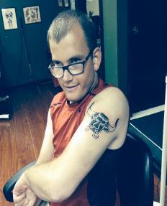
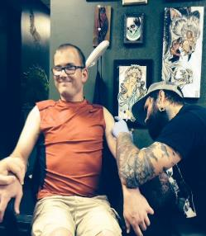
Ben’s Good Life Vision
Family Friends TATOOS
Vacations Girlfriend
Concerts WWE Nascar
Money Job/own business
Fire Station Church
Tiger Football Royals
Good Food Pepsi Beer
Active Healthy & Fit
Poverty/No Money
Poor Health Diabetes
Heart Disease Guardian
Isolated/Segregated
Institution/group home
Treated Differently
Notes:
Trajectory isn’t always straight
Bumps in the road – you can get back on track
VISION and TRAJECTORY can be very broad or very specific and time limited. Might be what are we doing/what’s happening this week?

Slide 32
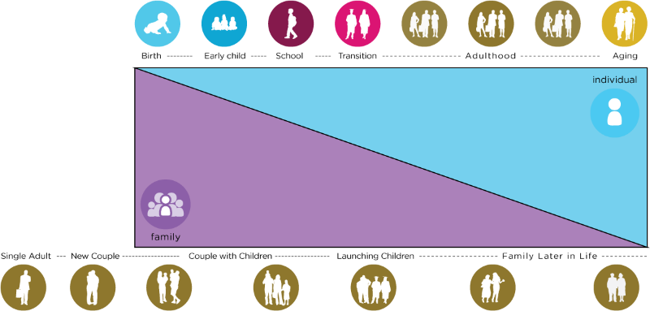
Family Life Cycle
Life Stages and
Individual and Family Cycles
Individual Life Stages
Notes:
Have to consider the individual’s stage of life, but also where other family members are in their lives. Are the parents aging? Are the siblings raising their own families? Is a sibling going away to college?
Stages – what happens in early or any stage, affects the stages to come.
Stages – what happens in early or any stage, affects the stages to come. You have them for only a very short time in their lifespan, but what happens in those years can have profound effect on future (adult) years!
*45 Year old PWD – parent is 65 or older and might be caring for their own elderly 95 year old parent!
*12 year old with autism – also has a new baby in the house.
Consider the person you support in the context of their whole family dynamic!

Slide 33
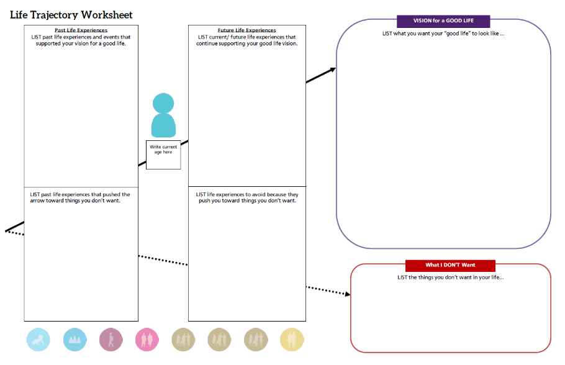
Ben’s Life Trajectory
Chores; boy scouts;
School inclusion/circle of friends;
Birthday parties;
Riding bike;
Family vacations;
Church youth group; Debit card;
Football manager; Homecoming king; Volunteering
High School diploma
Family and friends
Girlfriend
Vacations
Concerts; WWE; Nascar
Tattoos
Money; job or my own business
Volunteer at fire station
Being Tiger football manager
Church
Healthy & fit
Good food; Pepsi
Basketball
Royals baseball
Staying active
Volunteer at fire station; Find more volunteer ops; Workout regularly;
Keep in touch w/ friends; Increase alone time;
Go out with friends; Spend daytime hours out of the house;
Explore micro enterprise;
25
Special education low expectations;
Para glued to Ben’s side; Pressure to segregate; Medication side effects;
Scoliosis;
Seizures;
Physical barriers;
Sitting at home watching TV all day;
Rely on paid supports;
Gain weight;
Eat unhealthy foods or drink too much Pepsi (caffeine);
Poor health, heart disease, diabetes; Poverty/no money;
Guardianship; institution/group home; Segregation/isolation; being lonely
Being treated differently;

Slide 34
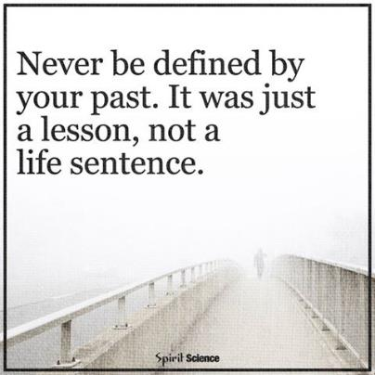
Dignity of Risk and Mistakes
Friends, family,
enough money,
job I like, home, faith, vacations, health, choice, freedom
Poverty, loneliness, segregation, restrictions, lack of choice, boredom
Notes:
People need to be allowed to take risks and make mistakes – and not pay for it forever. We all make mistakes and move past it – but PWD often are labeled or restricted for life if they make even a simple mistake. “fire-starter” “sexual predator” “can’t use the internet”
Person doesn’t learn to STAY SAFE if someone is always protecting them from everything!

Slide 35
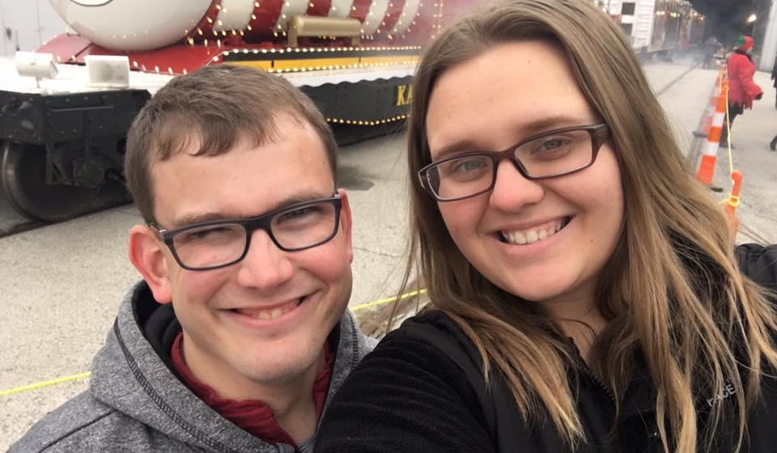
Individualized Supports to Achieve a Good Life

Slide 36

Three Types of Supports
Goods &
Services
(Day to Day, Medical, Financial Supports)
Discovery & Navigation
(Info and Training)
Connecting & Networking
(Talking to Someone that has been there)
Notes:
The 100% can have access to the 3 buckets - even if they never receive formal services
YOU don’t have to know everything or provide it – but you can refer them to someone that does. Every state has a family to family organization, and many have parent to parent networks.

Slide 37
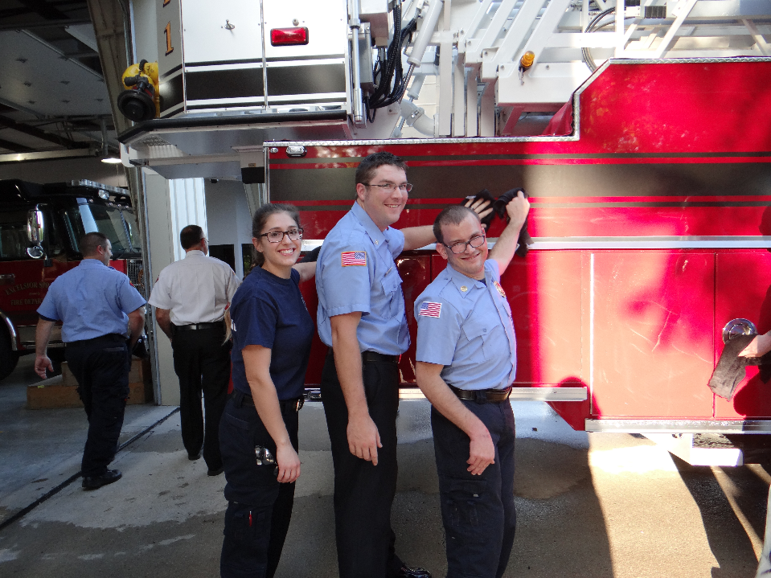
Integrated Star for Problem Solving & Exploring Options
Notes:
HOW do we get the supports needed for the GOOD LIFE???

Slide 38
Integrating Services and Supports
75%
People with I/DD not receiving formal DD services
25%
People with I/DD receiving formal DD services
100%
People with I/DD receiving integrated services and supports

Slide 39
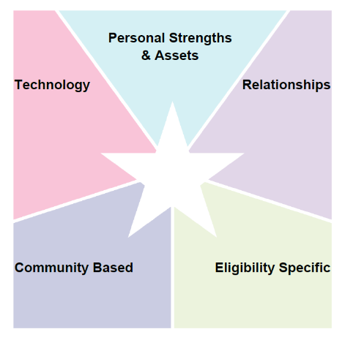
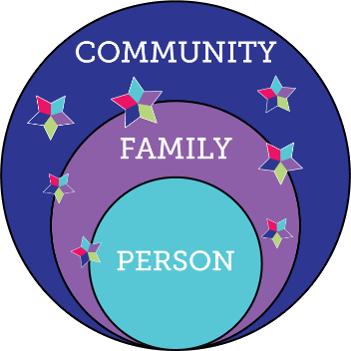

LifeCourse Integrated Supports STAR
resources, skills, abilities characteristics
i-pad/smart phone apps, remote monitoring, cognitive accessibility,
Adaptive
equipment
family, friends, neighbors, co-workers, church members, community members
school, businesses, church faith based, parks & rec, public transportation
SHS services, Special Ed, Medicaid, Voc Rehab, Food Stamps, Section 8
R
100%
Notes:
MAPPING
PROBLEM SOLVING
PLANNING LTSS
PLANNING ACTIVITIES
We ALL do this without even thinking about it

Slide 40
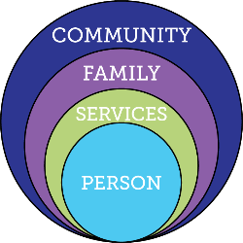

Focusing ONLY on Eligibility Supports
Friends, family, enough money,
job I like, home, faith, vacations, health, choice, freedom
Eligibility Supports
Poverty, loneliness, segregation, restrictions, lack of choice, boredom, institutions
Notes:
Story about family asking permission for their son (who doesn’t receive services for housing) to move into his own apartment
OATS bus -

Slide 41
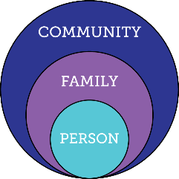

Relying ONLY on Family & Friends
Friends, family, enough money,
job I like, home, faith, vacations, health, choice, freedom
Relationships
Poverty, loneliness, segregation, restrictions, lack of choice, boredom, institutions

Slide 42
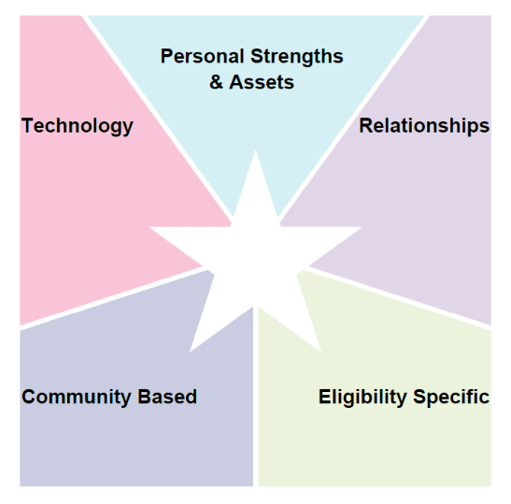
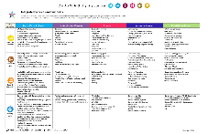

Daily Routine
Morning or Evening
Notes:
Activity 7: Integrated Supports Star large group discussion: Large 11x17 Star worksheet
Ask participants to call out the things they use to get through their day. IE: what types of supports do you use to get through your morning routine or evening routine? (5 minutes)
Record the things used to accomplish the routine on the flip chart or poster board as they call it out
IE: alarm clock =technology, Starbucks = community, meal with family = relationships, school buss – community, carpool – relationships, morning person: personal strength, etc.
Facilitate large group discussion, lead, nudge or pull them to the realization that we all use integrated supports every day?

Slide 43
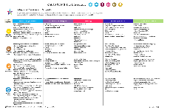
Problem Solving:
Life Domain
Life Domain
Notes:
Write Life Domain in center
Activity 8: Integrated Supports Star table activity: large star work sheet titled Problem Solving by Life Domain Scenario (15 minutes)
Assign each table one of three separate scenarios:
Making friends
Learning to cook
Getting first job
Discuss the supports a person with SHCN could use to accomplish the task
One person record ideas on large star worksheet
Large group follow up – facilitate discussion
What types of things did you come up with?
Were there any innovative supports mentioned at your table?
TEACHING people to problem solve – NOT about filling out a tool but teaching the skills to problem solve!!!

Slide 44
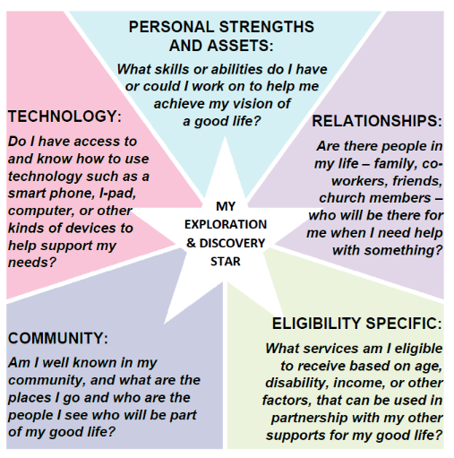
LifeCourse Integrated STAR: Exploration & Discovery (Mapping)
Notes:
Use it like a bank you can pull from when problem solving or working on supports or activities.

Slide 45
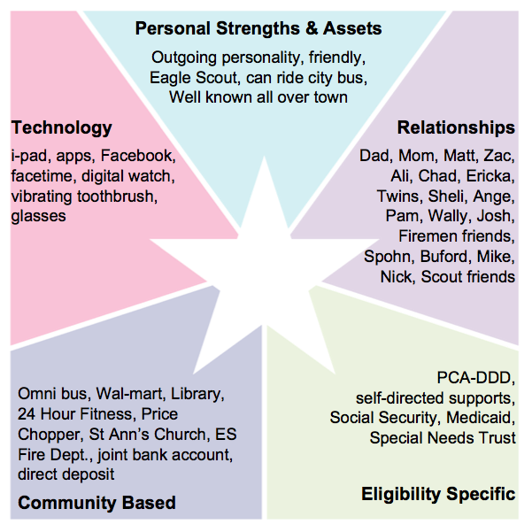
Ben’s STAR for Exploration and Discovery
(mapping)
Ben’s
Integrated
Supports

Slide 46
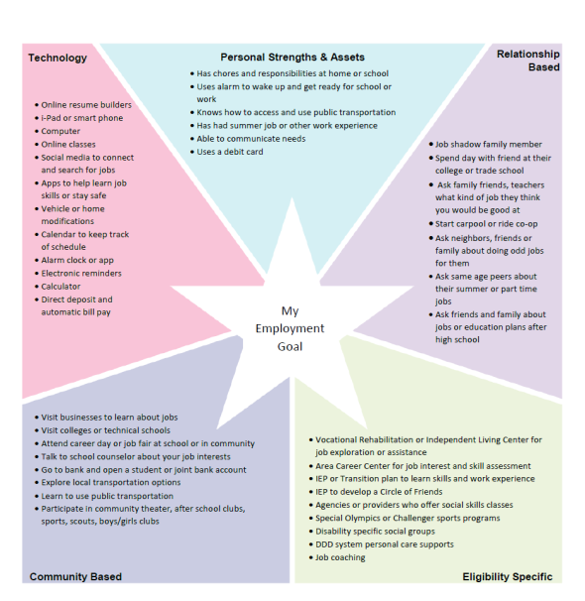
Domain Specific
Daily Life: Focus on Employment

Slide 47
Safety and Security: focus on
Supported Decision Making

Slide 48
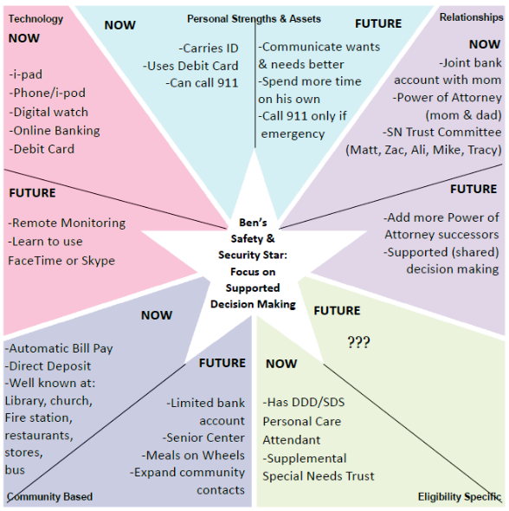
Ben’s Safety & Security Star
Focus on Supported Decision Making
Notes:
Now and future – succession planning

Slide 49
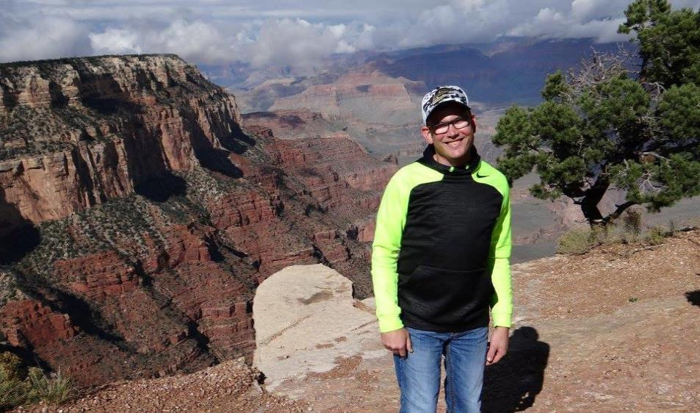
LifeCourse Star to Calendar

Slide 50


Ben’s Services and Supports
Able to stay home alone for up to an hour; has & can use i-pad;
i-pad when home alone; digital watch
Mom, Dad, Matt, Zac, Ali, Chad, Ericka, Roy, Carol, Nick, Spohn,
Ben’s Services & Supports
Firemen at ESFD; coaches & staff at ES high school; Omni bus;
DDD Self-Directed waiver PCA staff; Medicaid; Special Needs Trust
Notes:
Mom and service system figuring out oversight – who and how Ben is being supported 24 hours a day

Slide 51


Moving to Integrating Supports

Slide 52
Ben’s Life Activities
Can stay home alone for up to one hour
I-pad to watch WWE network and music videos; facebook
Mom, Dad, Matt, Zac & Ali; firemen friends; Nick, Spohn, Mike,
Ange, Chad, Ericka & twins
Ben’s Life Activities
Fire Station, Wal-Mart, movies, bowling, Sonic, Price Chopper, Church, High School, IHD
Paid staff thru SD waiver help with activities, ADL’s & access community; therapeutic riding
Notes:
Family and staff figuring out what Ben does during the day (and evening).

Slide 53






Notes:
First show the person,
Then show the family,
then bring up the domains
And then the buckets
And then the outer layers
All these things work together to make a good life.

Slide 54

Calendar to Star/Planning

Slide 55




Life Course Case Studies
Notes:
EVERYBODY in ES knows Ben! You can’t walk thru Wal-Mart without half dozen people talking to Ben.
He learned to ride the Omni bus as part of his transition plan, and he would go to WalMart and Price Chopper and use his debit card to make purchases from a list.
“live in the basement”
Spending some time alone
Our house in Ben’s Special Needs Trust
Shared Living

Slide 56


scenarios
Notes:
Use what you know
Think about questions you’d need to ask or what you need to discover
CHALLENGES
HOW did you get started???

Slide 57


Elizabeth age 5

Slide 58

Elizabeth’s Life Trajectory

Slide 59

Elizabeth’s
Integrated Star:
Mapping Supports
:

Slide 60

Using LifeCourse for Specific Issue

Slide 61

Peyton’s Plan for Inclusion in
School
Using the LifeCourse Tools to Transform the Way the School Thinks about Inclusion for Peyton
Notes:
How the Story Began: Peyton
Family wants Peyton to attend the neighborhood school with his brother and his school age peers
School believes that Peyton will be best supported in a next year in a segregated setting, in a different building which does not have students his age
During the IEP meeting, the school and parent became grid-locked on a what more inclusive day could look like for Peyton (he was not included in homeroom, lunch, specials or other general education class)
Two weeks later, Mom brought Peyton’s trajectory, integrated star and weekly schedule to the follow-up IEP. The school better understood what she wanted and have made more concrete strides at meeting his inclusion needs.

Slide 62

Peyton’s Good Life Trajectory
Friends
Family
Productive Employment
Happiness
Living Independently
Meaningful Relationships
Love
Community Involvement & Inclusion
Sheltered Workshop
Group Home
Isolation
Dependency on paid supports
Lonely
Unhappy, unproductive, bored
Poverty

Slide 63


Peyton’s Integrated Supports

Slide 64

LifeCourse Integrated STAR: Problem Solving

Slide 65

Jessica’s Transition Plan

Slide 66

Jessica’s Trajectory

Slide 67

Vision for a Good Life

Slide 68

What Jessica Doesn’t Want

Slide 69
LifeCourse Tools Video
https://youtu.be/hWrGklhlKgA

Slide 70

Activities
This Photo by Unknown Author is licensed under CC BY-NC-SA
This Photo by Unknown Author is licensed under CC BY-SA

Slide 71
Questions, Reflections and Discussion

Slide 72
Contact Information
Karen.coffey@mh.alabama.go
Myra Jones@mh.alabama.gov

Slide 73







THANK YOU!!!

